Slide 1
HOLIDAY HOMEWORK
CLASS 1 (2024-2025)
HOLIDAY HOMEWORK
CLASS 1 (2024-2025)

Slide 2
GENERAL GUIDELINES
As per NEP guidelines holiday homework is integrated , child centric and creative for the holistic development of the child.
Support and encourage your child to do holiday homework himself or herself along with pictures .
Use waste materials eg: Newspaper, old clothes , magazines , bangles , buttons etc. to instill the value of using waste materials wisely.
Do one page daily of both English and Hindi cursive writing books.
Read one story daily from English and Hindi supplementary books.
Appreciate nature – Go for a walk in the park or a garden with family members or friends . Capture the moments in the form of pictures as the lifetime memories . Adopt or grow a plant.
Unravel an artist in you. Create a new story , try new recipes with your mom , learn something new ( a song , an instrument or a sport etc.).
Good manners are the key – respect your parents / grandparents . Use magical words.

Slide 3
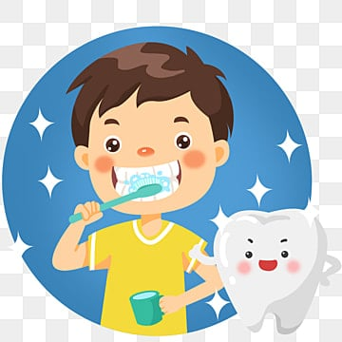
TIPS FOR HEALTHY LIVING
Stay fit and healthy. Maintain proper hygiene.
Brush your teeth twice a day
Trim your nails once a week
Use electricity wisely
Save every drop of water
Keep your surroundings clean
Exercise regular
Keep your country clean
Always carry your own steel/ glass bottles instead of plastic bottles whenever you go out as plastic bottles are harmful for health.

Slide 4
Let’s embrace the nature
As mango is the king of the fruits and kids love to eat them. So let’s have them all around us. So, follow the steps and grow them all.
NOTE-Every mango seed does not grow so don’t get disheartened and keep trying. The child who will grow and maintain the mango plant will be felicitated by the school.

Slide 5
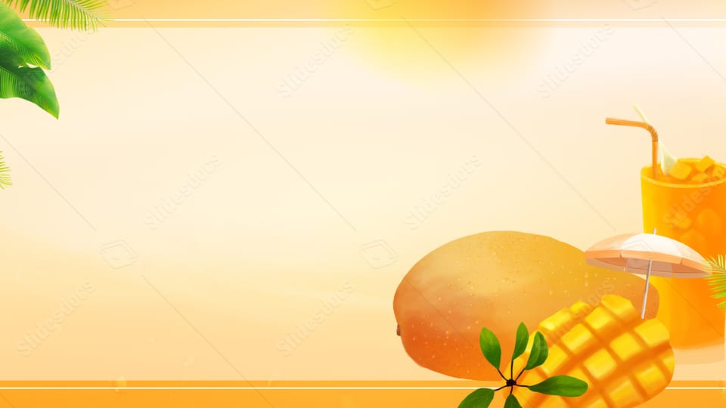
Sow the Mango seed
Sow the seed in a waste container.
Water it regularly.
Keep it in proper sunlight.
Observe it , click pictures and paste them in the holiday homework file.
Mention the date it is sown , the sapling you saw for the first time and measure it’s length twice a week.
Sow the
DATE | OBERVATION | MEASUREMENT | DRAW AND COLOUR

Slide 6
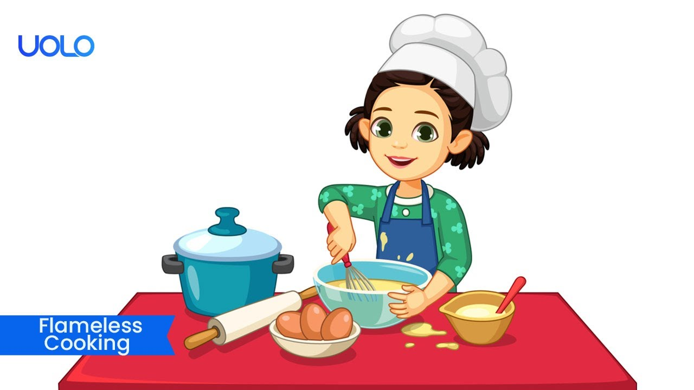
FLAMELESS COOKING
Make a healthy salad or fruit chat.
Write down the ingredients used along with their quantity and their nutritional values.
Wear a chef cap and an apron and click the pictures with your dish.

Slide 7
व्यायाम स्वस्थ जीवन का आधार है । इन गर्मी की छुट्टियों मे आप योगा आसनों का अभ्यास करें और खेले कूदे I
योग आसन करते हुए अपनी फोटो खींचकर लगाइए ( कोई पाँच आसन ) ( उनके नाम सहित) |

Slide 8
Open the fridge . Make a list of the things kept in the fridge . Count them and write their number names eg : Eggs = 2 = two and complete the table accordingly.
Name of the item | Quantity | Number Names | Healthy | Unhealthy | Substitute
EGGS | 5 | FIVE | YES | ---- | ----
TOMATO SAUCE BOTTLE | 1 | ONE | ----- | YES | HOMEMADE TOMATO CHUTNEY

Slide 9
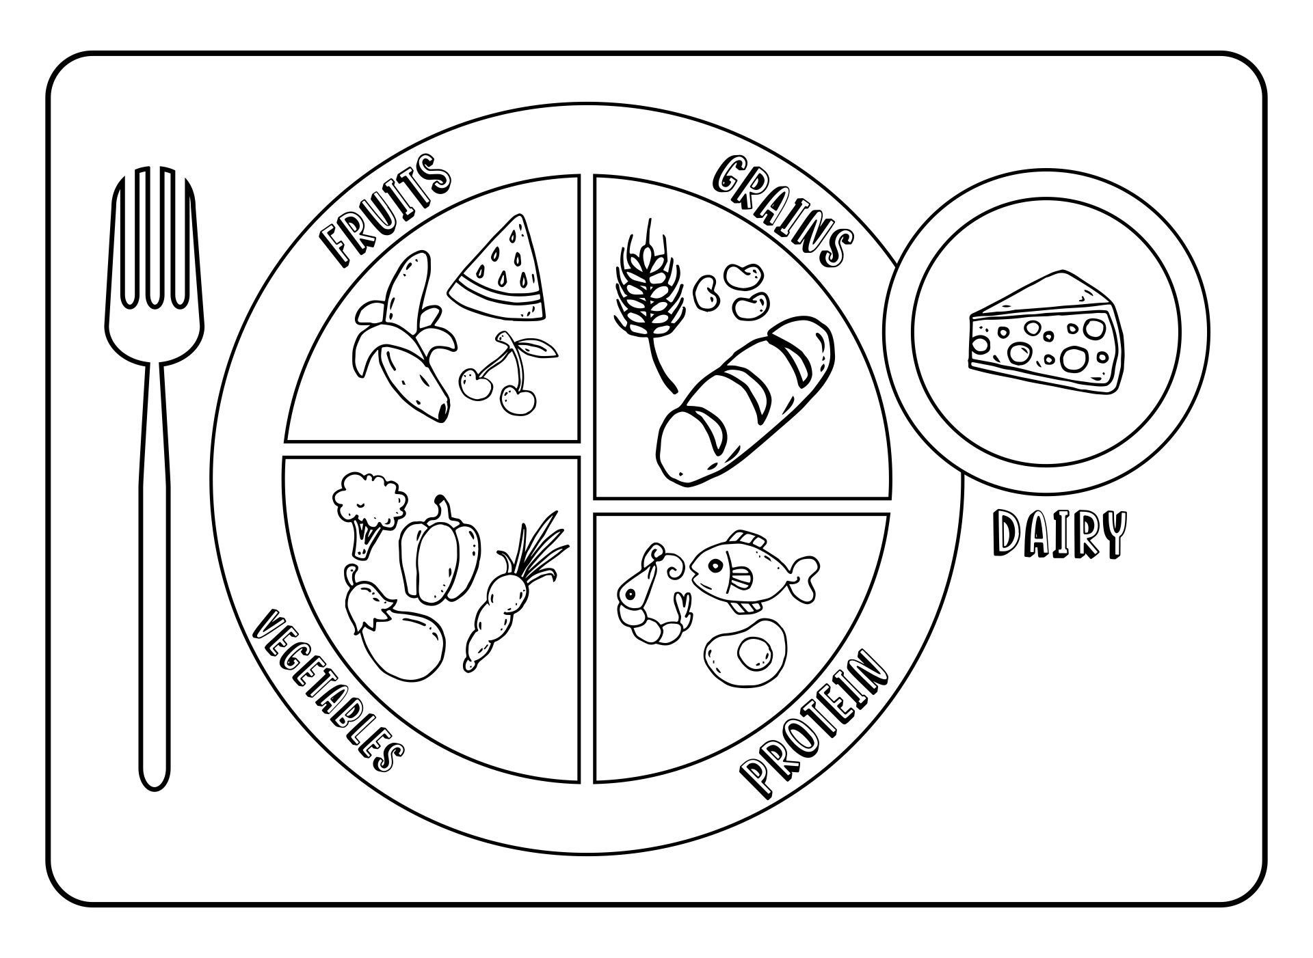
Make 3 healthy and colourful plates you eat in your 3 meals. ( breakfast , lunch , dinner)
Write the names of the included in your meals starting from breakfast. Click their pictures and paste them in your files.

Slide 10
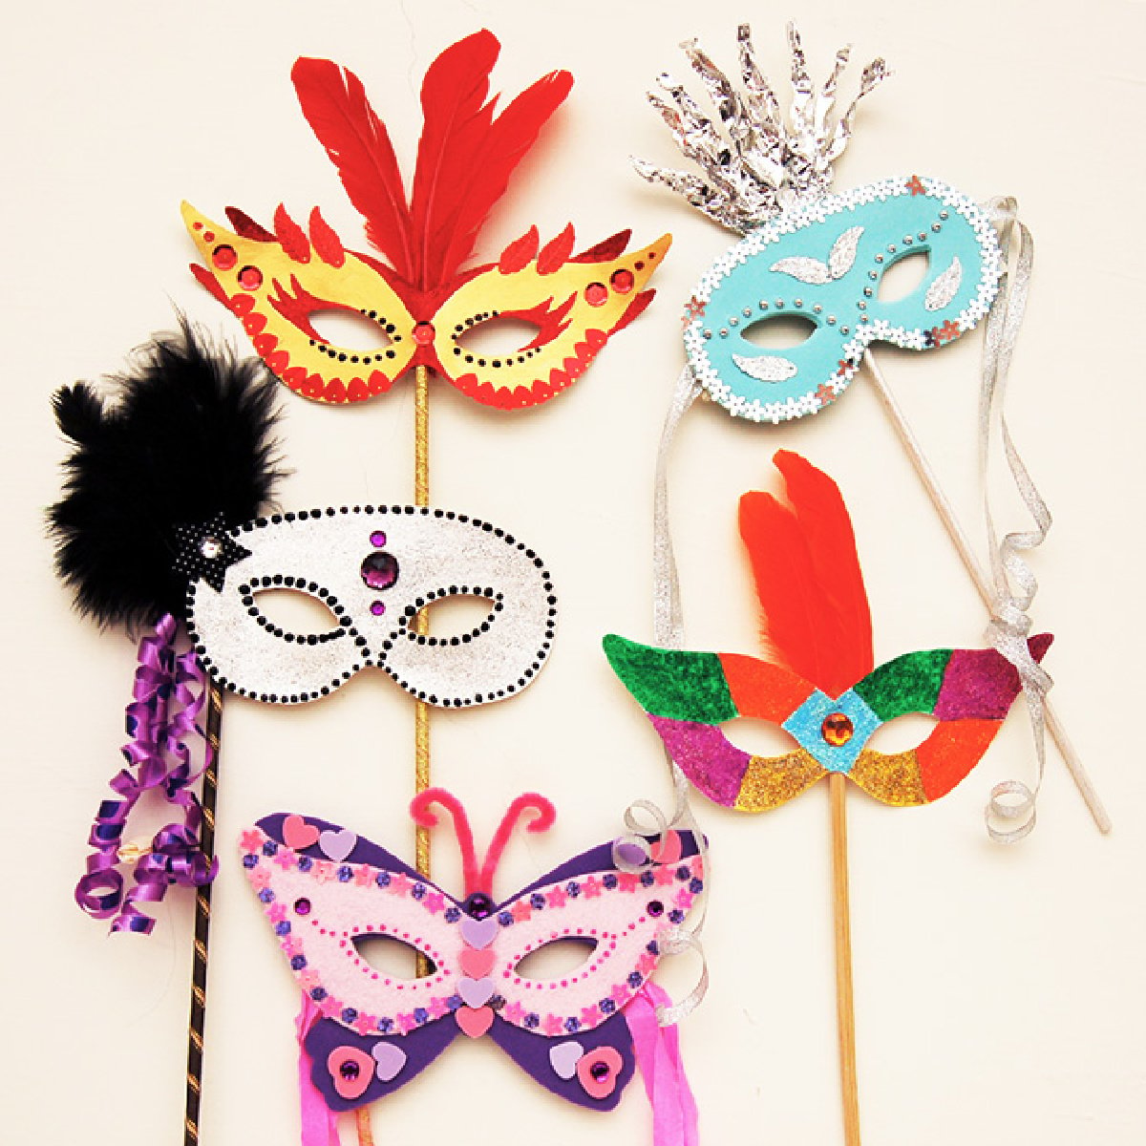
Art Holiday Homework
Make Fruit Masks
Materials required-:Colour papers, wedding cards , glitter sheets, sticks, fevicol ,decorative materials etc.

Slide 11
Models
Jallianwala Bagh(Roll no.1-10)
Rose Garden (Roll no. 11-20)
Rock Garden(Roll no.21-30)
Lodhi Fort (Roll no 31-40)

Slide 12
Charts
Wagah Border (Roll no 1-10)
Dances of Punjab (Roll no 11-20)
Maharaja Ranjit Singh war Museum(Roll no 21-30)
Cuisines of Punjab (Roll no 31-40)

