Slide 1
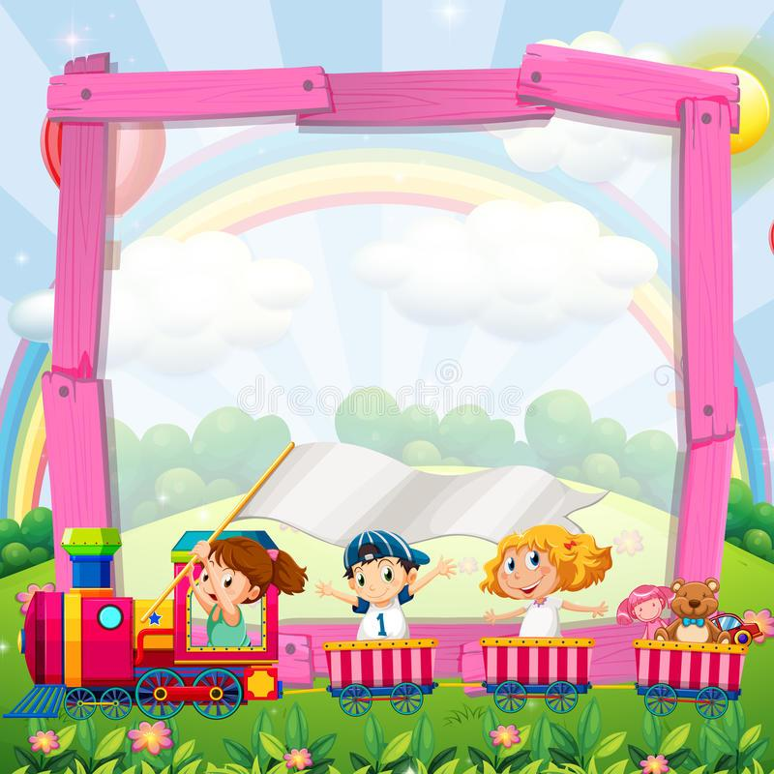
COLUMBIA FOUNDATION SR. SEC. SCHOOL
D- BLOCK, VIKASPURI
CLASS – 1
HOLIDAY HOMEWORK
( 2023 – 2024 )

Slide 2
As the holidays begun, its time for us to have some fun.
It is the time to read an amazing book and help mommy cook.
We will make new friends and play a lot of games.
Spend time with them and know their names.
We will sleep on time and rise with the bright sun.
As the holidays have begun, its time for us to have fun.

Slide 3
The objective of holiday homework is to enable our toddlers work independently and also to improve their reading skills
Reading enhances understanding power and boosts child’s confidence.
Good habits and good manners are lifelong assets and these must be practiced until they become a habit.
READING TIME
Read two moral stories in hindi and english.Write their moral values and draw or paste pictures of these stories.
Follow personal hygiene and write five lines on the same and paste beautiful pictures also.
FAMILY TIME
Spend quality time with your parents ,grandparents and paste photographs of the same.
Indulge yourself in other ways of entertainment instead of phones, TV’s .
Learn any musical instrument.
Adapt a hobby like dancing, reading , sports etc that you can do in your free time .

Slide 4
GENERAL INSTRUCTIONS
Holiday Homework for all the subjects is to be done in common file, (A- 3 sheets compiled together).
The cover page of the file should be attractive, colourful and decorated.
Illustrate the work with pictures.
Do not use thermocol because it is harmful for the environment.
Use only waste material (newspaper, old magazine, laces, buttons, fruit seeds, pencil shavings, waste plastic etc.) for model and file.
Revise the work done in all subjects.
Do your work very neatly in your own handwriting. Take help from your parents when required.

Slide 5
Dear Parents,
The following tips would help your child spend these holidays in a learning way…..,

Slide 6
INNOVATION can be defined simply as a new idea, device or method. In other words, innovating something that makes your complicated routine simplified.
Encourage your child to innovate or create something of his own that can be of a great help for the society or environment.
The school will acknowledge such students,
So, come up with your unique ideas.

Slide 7
HELLO KIDS
it’s vacation time for you all. let’s make these holidays interesting and engrossing . imagine you are a gennie from clean land (pollution free land).your goal is to create a sustainable world for all. together, we will call for action to protect this green and clean world.

Slide 8
POLLUTION
Pollution is the effect of unwanted changes in our surroundings that have adverse effects on animals, plants and human beings . Pollution is mainly of three types LAND,AIR,WATER .
Different types of waste material which contaminate our surroundings are
Plastic
Newspaper
E -waste
kitchen waste
Industry waste
Keeping all these things in mind holiday homework has been framed to create an awareness among students for the same.

Slide 9
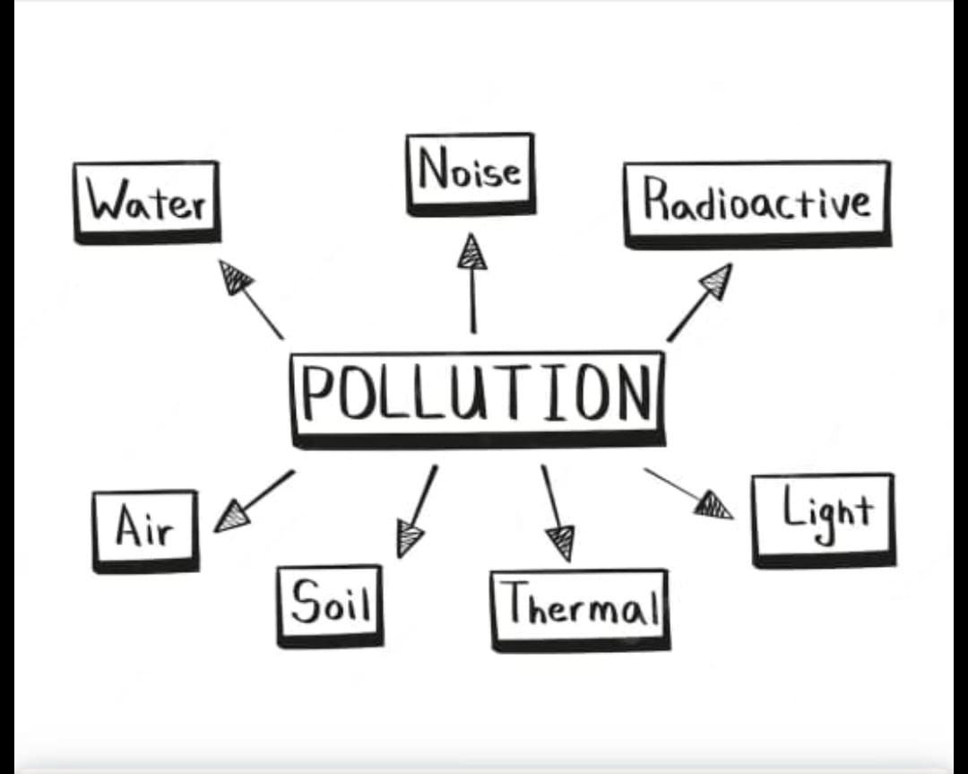
English
Draw two mind maps showing ;
Adverse affects of land pollution .
How to control that?
Write the number names of the affects and solutions.

Slide 10
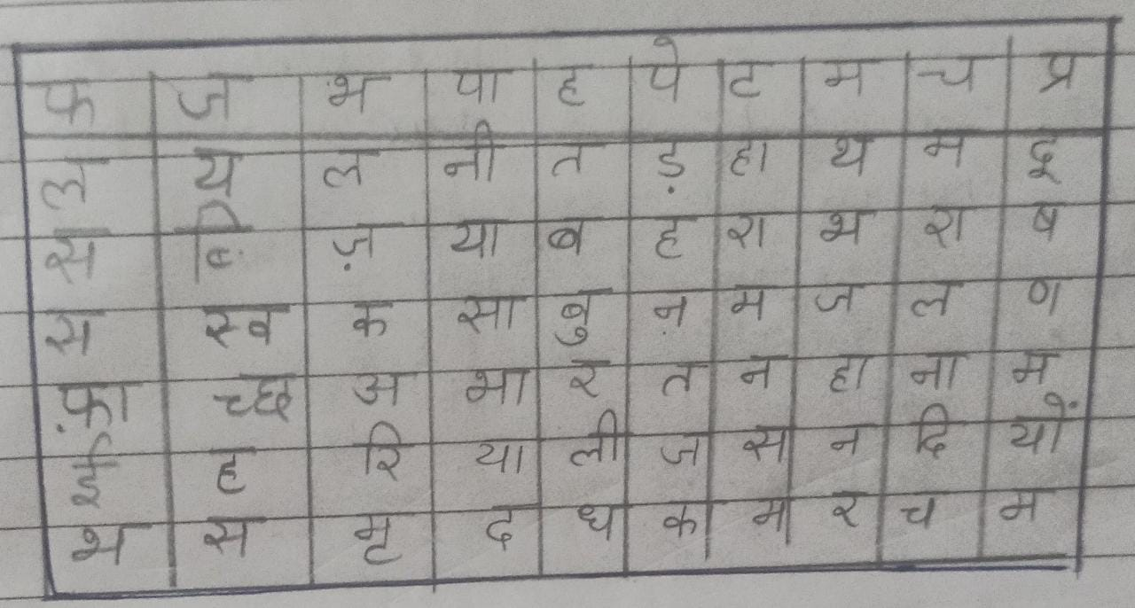
HINDI
शरीर को स्वस्थ रखने के लिए पौष्टिक भोजन, स्वच्छ शरीर और शुद्ध वातावरण अनिवार्य है। तो आइए खेल - खेल में दिमाग की कसरत करते हुए कुछ अच्छी बातें सीखें, शब्द ढूंढें और नीचे लिखे वाक्य पूरे करें :-
1. ___ और ___ खाना सेहत के लिए लाभदायक है।
2. खाना खाने से पहले ___ से ____ धोने चाहिए।
3. गंदा ___ पीने से हम बीमार हो जाते हैं।
4. वातावरण को शुद्ध करने के लिए एक - एक _____ लगाना चाहिए।
5. धरती को ___ बनाना है, ____ से बचाना है।
6. ____ को अपनाएं,खुशहाल जीवन पाएं।
7. ___ में कूड़ा - कचरा न डालें।

Slide 11
HINDI
Read one story everyday from supplementary book ‘Suno kahani’ and underline the difficult words from each lesson.

Slide 12
maths
Find 5 main rivers in India and paste their pictures. Find and write the largest and smallest rivers.
Identify the vehicles that create pollution. Arrange them in the ascending and descending order.

Slide 13
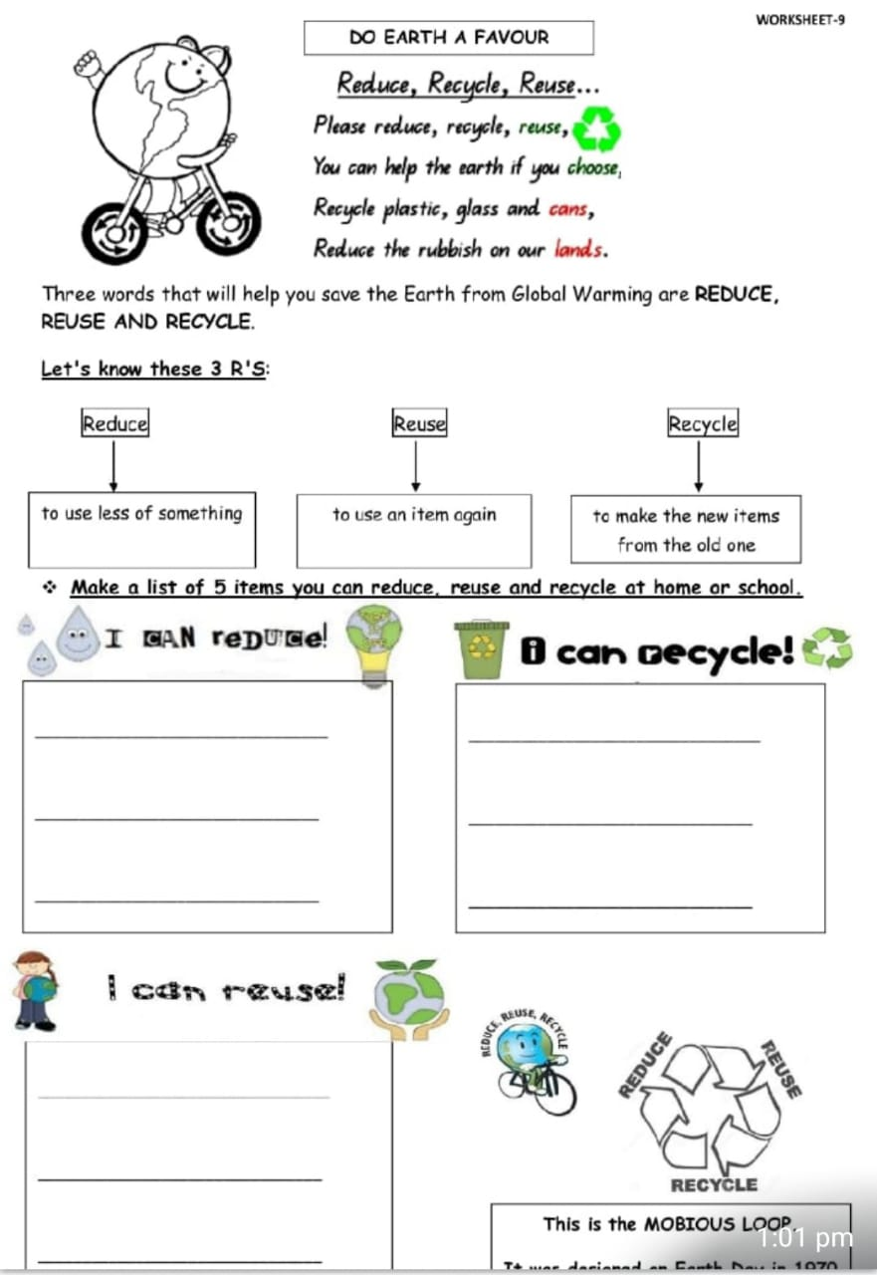
E.V.S
Three words that help us to save the earth from pollution. REDUCE,REUSE,RECYCLE
(3R’s).Make a list of 5 items you can reduce ,reuse and recycle at home.

Slide 14
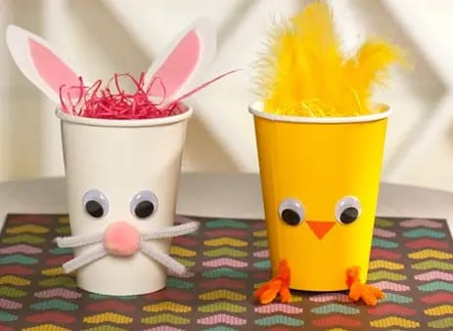
ART
MAKE FOUR DIFFERENT ANIMALS WITH WASTE ICE CREAM CUPS.

Slide 15
MODELS AND POSTERS
CLASS I A
Topic - Land Pollution
Land fill / Dumpyard(Roll no.1 - 10)
Industries / Factories creating pollution (Roll no.11-20)
Deforestation (Roll no.21- 30)
Afforestation (Roll no. 31-35)
Recycle industries (Roll no. 36-41)
[0:25 pm, 25/05/2022] Mrs Kapoor: Make a sustainable city model to save electricity.[0:26 pm, 25/05/2022] Mrs Kapoor: Make a model on extinct and endangered species .[0:27 pm, 25/05/2022] Mrs Kapoor: Make posters for the same

Slide 16
MODELS AND POSTERS
CLASS I B
Topic - WATER POLLUTION
Waste from houses and industries going into rivers.(Roll no.1 - 10)
Effects of pollution on Aquatic life (Roll no.11-20)
Diseases caused by pollution (Roll no.21- 30)
Smart city with proper sanitation(Roll no. 31-35)
Replace disinfectants bioenzymes (Roll no. 36-41)
[0:25 pm, 25/05/2022] Mrs Kapoor: Make a sustainable city model to save electricity.[0:26 pm, 25/05/2022] Mrs Kapoor: Make a model on extinct and endangered species .[0:27 pm, 25/05/2022] Mrs Kapoor: Make posters for the same

