Slide 1
HOLIDAY HOMEWORK
CLASS 2 (2024-2025)
HOLIDAY HOMEWORK
CLASS 1 (2024-2025)

Slide 2
GENERAL GUIDELINES
As per NEP guidelines holiday homework is integrated , child centric and creative for the holistic development of the child.
Support and encourage your child to do holiday homework himself or herself along with pictures .
Use waste materials eg: Newspaper, old clothes , magazines , bangles , buttons etc. to instill the value of using waste materials wisely.
Do one page daily of both English and Hindi cursive writing books.
Read one story daily from English and Hindi supplementary books.
Appreciate nature – Go for a walk in the park or a garden with family members or friends . Capture the moments in the form of pictures as the lifetime memories . Adopt or grow a plant.
Unravel an artist in you. Create a new story , try new recipes with your mom , learn something new ( a song , an instrument or a sport etc.).
Good manners are the key – respect your parents / grandparents . Use magical words.

Slide 3
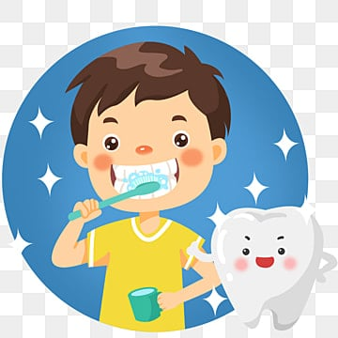
TIPS FOR HEALTHY LIVING
Stay fit and healthy. Maintain proper hygiene.
Brush your teeth twice a day
Trim your nails once a week
Use electricity wisely
Save every drop of water
Keep your surroundings clean
Exercise regularly
Keep your country clean
Always carry your own steel/ glass bottles instead of plastic bottles whenever you go out as plastic bottles are harmful for health

Slide 4
Let’s embrace the nature
As mango is the king of fruits and kids love to eat them. So let’s have them all around us. So, follow the steps and grow them all.
NOTE-Every mango seed does not grow so don’t get disheartened and keep trying . The child who will grow and maintain the mango plant will be felicitated by the school.

Slide 5
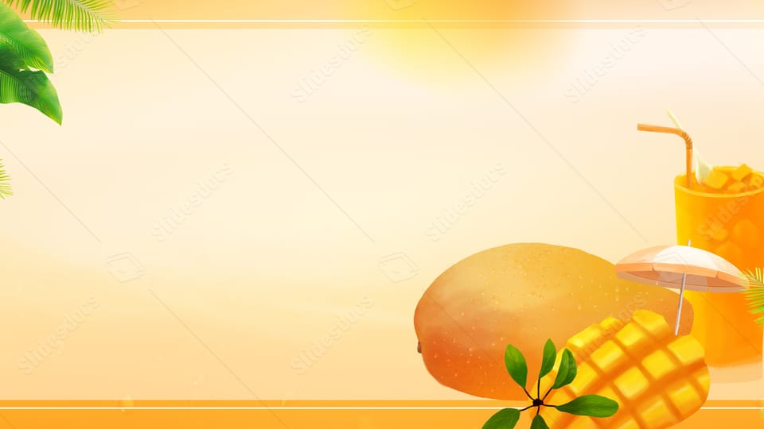
Sow the Mango seed
Sow the seed in a waste container.
Water it regularly.
Keep it in proper sunlight.
Observe it , click pictures and paste them in the holiday homework file.
Mention the date it is sown , the sapling you saw for the first time and measure it’s length twice a week.
Sow the
DATE | OBERVATION | MEASUREMENT | DRAW AND COLOUR

Slide 6
Wearing neat and clean dress boosts our confidence . We feel good about ourselves.
Make your favourite beautiful dress using waste materials eg: newspaper , cotton , wool , old clothes , wrappers etc.
Stand in front of the mirror and speak these lines
(a) I am very beautiful.
(b)I am strong.
(c)I am a confident child.
Should you wear neat and clean uniform to school also ? Why?

Slide 7
किसी भी बदलाव की शुरुआत पहले स्वयं से होती है। इसी तरह साफ-सफ़ाई की शुरुआत भी सबसे पहले अपने आस-पास से होती है।
कुछ वाक्यों द्वारा दर्शाइए की आप अपने कमरे को किस तरह से साफ़ और व्यवस्थित रखेंगे।
अपने कमरे का एक सुंदर चित्र भी बनाइए और चिपकाइए।

Slide 8
Make a list of the things you use to keep yourself clean from head to toe along with their Cost /Price (first 15 days). Also paste or draw the picture of the things or items mentioned in the list. Add the cost of all the items as well.
Days | List of items | Cost/Price | Total amount

Slide 9
Make 3 healthy rainbow drinks .
Write their ingredients and nutritional values.
Draw or paste their pictures and write their recipes as well.

Slide 10
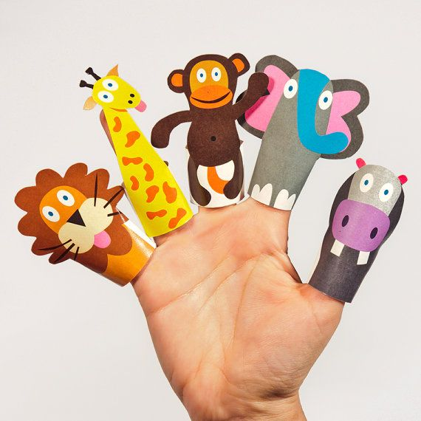
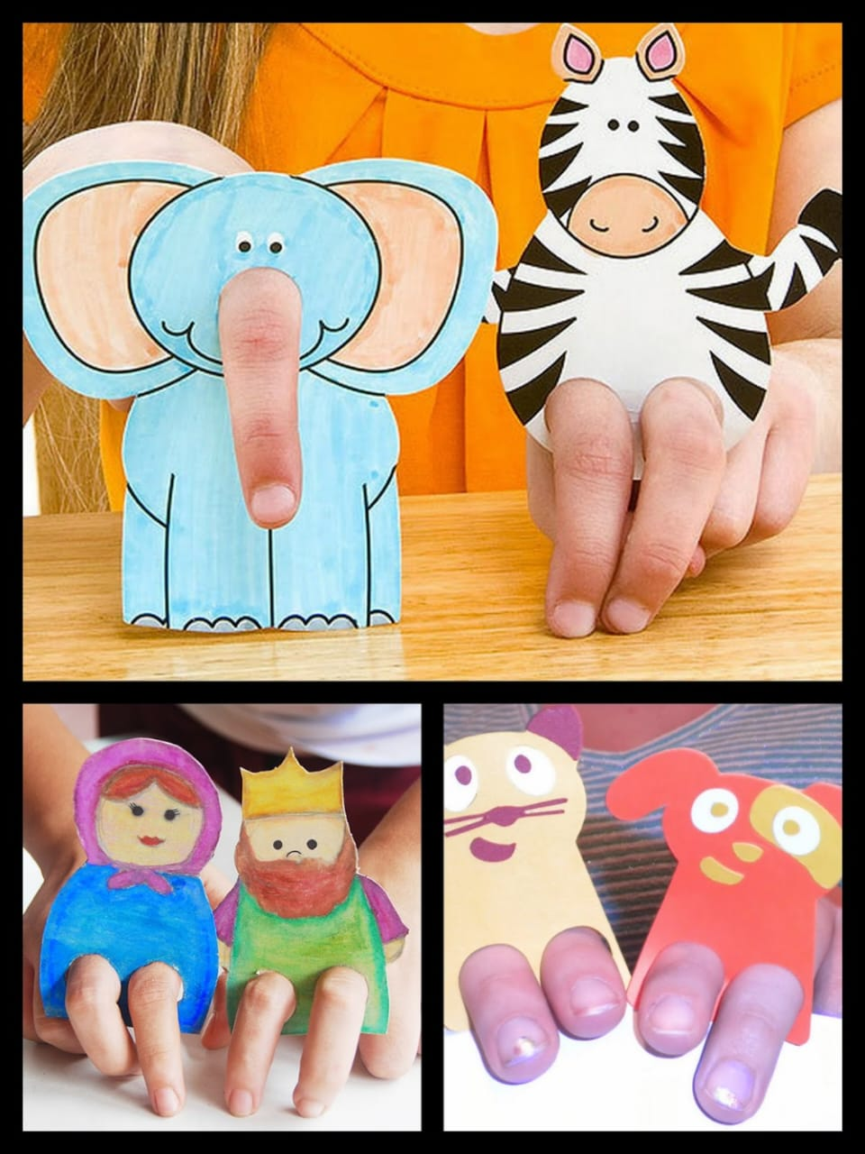
Art Holiday Homework

Slide 11
Models
Kurukshetra (Roll no.1-10)
Agricultural land (Roll no. 11-20)
Dairy farms of Haryana (Roll no.21-30)
Sultanpur bird Sanctuary (Roll no. 31-40)

Slide 12
Charts
Famous Sports Personalities (Roll no.1-10)
Famous Cuisines (Roll no. 11-20)
Karna lake with its history (Roll no.21-30)
Folk dances of Haryana (Roll no. 31-40)

