Slide 1
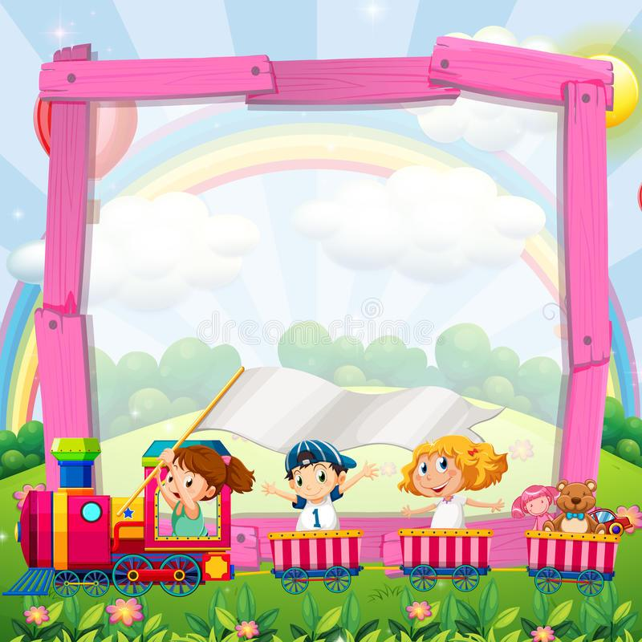
COLUMBIA FOUNDATION SR. SEC. SCHOOL
D- BLOCK, VIKASPURI
CLASS – 2
HOLIDAY HOMEWORK
( 2023 – 2024 )

Slide 2
As the holidays begun, its time for us to have some fun.
It is the time to read an amazing book and help mommy cook.
We will make new friends and play a lot of games.
Spend time with them and know their names.
We will sleep on time and rise with the bright sun.
As the holidays have begun, its time for us to have fun.

Slide 3
The objective of holiday homework is to enable our toddlers work independently and also to improve their reading skills
Reading enhances understanding power and boosts child’s confidence.
Good habits and good manners are lifelong assets and these must be practiced until they become a habit.
READING TIME
Read one page of any story book daily. Underline difficult words. Write them in your rough copy daily and learn them.
Follow personal hygiene and write five lines on the same and paste beautiful pictures also.
FAMILY TIME
Spend quality time with your parents ,grandparents and paste photographs of the same.
Indulge yourself in other ways of entertainment instead of phones, TV’s .
Learn any musical instrument.
Adapt a hobby like dancing, reading , sports etc that you can do in your free time .

Slide 4
GENERAL INSTRUCTIONS
Holiday Homework for all the subjects is to be done in common file, (A- 3 sheets compiled together).
The cover page of the file should be attractive, colourful and decorated.
Illustrate the work with pictures.
Do not use thermocol because it is harmful for the environment.
Use only waste material (newspaper, old magazine, laces, buttons, fruit seeds, pencil shavings, waste plastic etc.) for model and file.
Revise the work done in all subjects.
Do your work very neatly in your own hand writing. Take help from your parents when required.

Slide 5
Dear Parents,
The following tips would help your child spend these holidays in a learning way…..,

Slide 6
INNOVATION can be defined simply as a new idea, device or method. In other words, innovating something that makes your complicated routine simplified.
Encourage your child to innovate or create something of his own that can be of a great help for the society or environment.
The school will acknowledge such students,
So, come up with your unique ideas.

Slide 7
HELLO KIDS
it’s vacation time for you all. let’s make these holidays interesting and engrossing . imagine you are a gennie from clean land (pollution free land).your goal is to create a sustainable world for all. together, we will call for action to protect this green and clean world.

Slide 8
POLLUTION
Pollution is the effect of unwanted changes in our surroundings that have adverse effects on animals, plants and human beings . Pollution is mainly of three types LAND,AIR,WATER .
Different types of waste material which contaminate our surroundings are
Plastic
Newspaper
E -waste
kitchen waste
Industry waste
Keeping all these things in mind holiday homework has been framed to create an awareness among students for the same.

Slide 9
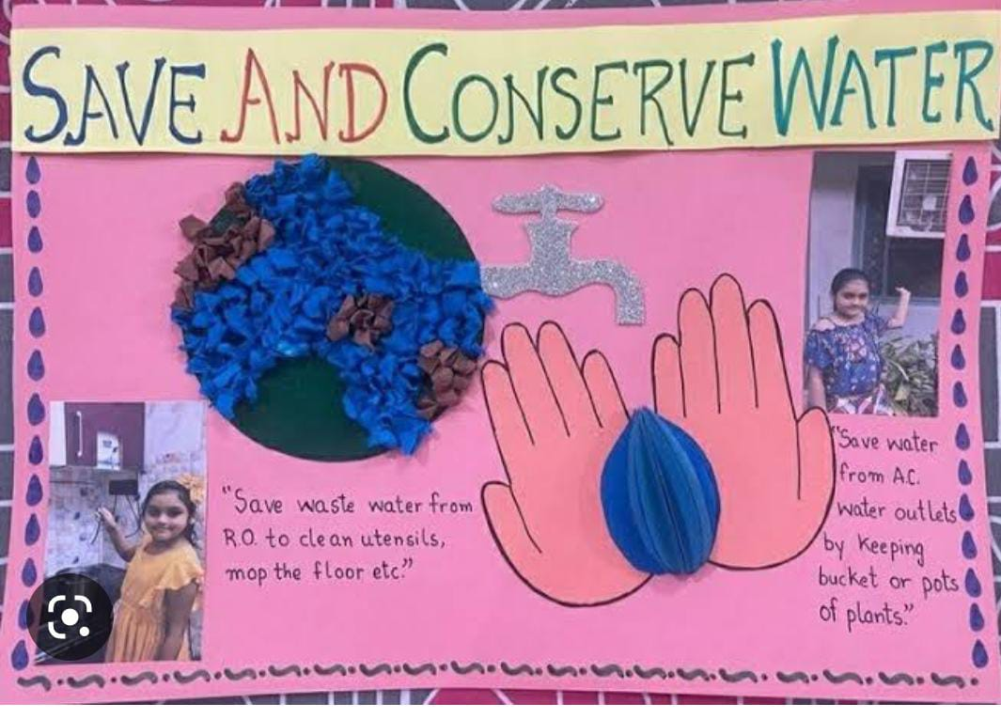
English
Collect the information about water sanitation in Delhi .Make a poster for the conservation of water and write 10 lines how can we conserve water. Following is the example for the same.

Slide 10
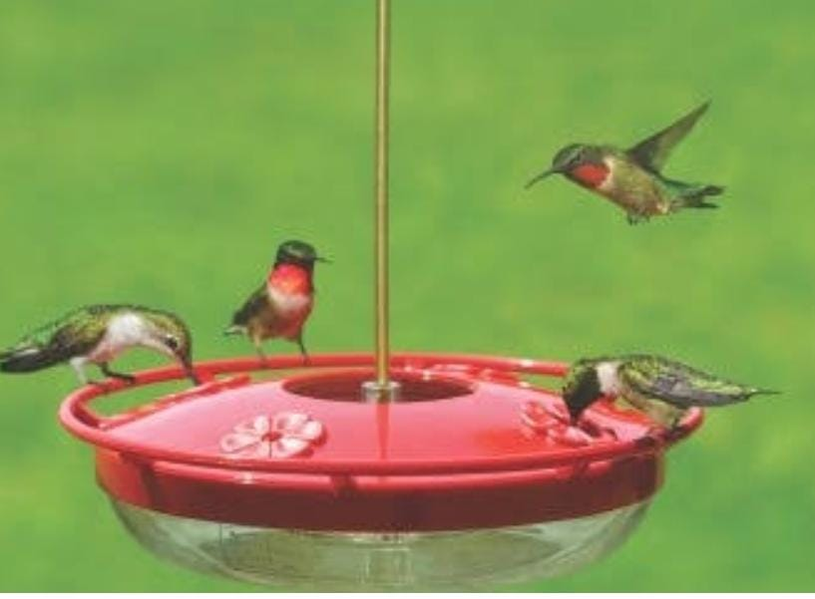
HINDI
1. वायु प्रदूषण किन किन कारणों से होता है? इस से होने वाली बीमारियों के नाम लिखिए। इस से बचने के उपायों को अपने शब्दों में लिखिए।
2. गौरैया के लिए प्रदूषित वातावरण और ऊंची इमारतें मुसीबत बन चुकी हैं ------ इस विषय पर एक कविता लिखिए जिस से लोगों को मूल्यवान संदेश मिले कि पक्षी और अन्य जीवजंतु भी इस प्रकृति का हिस्सा हैं और उन्हें भी जीवित तथा सुरक्षित रहने का अधिकार है।

Slide 11
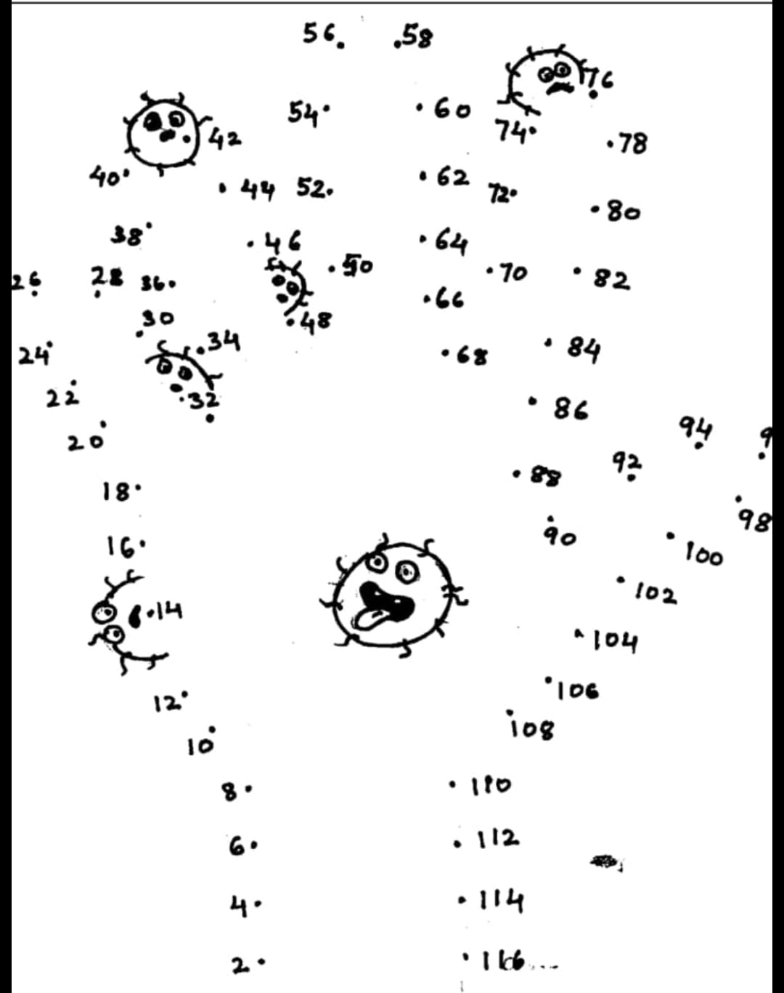
maths
Join the numbers by skip counting of 2 and find out on which part of the body along with its friends are dancing , feasting and making you sick.

Slide 12
maths
Identify 5 objects that causes pollution and cannot be recycled . Write their shape and also write few lines to dispose them .
Ex; Plastic Bottle –SHAPE(Cylinder)---DISPOSE(Can be used as flower pot)

Slide 13
EVS
Collect information about 5 National Parks in India that preserves animals and provide them comfortable habitat.
Paste pictures of National Sancturies.
Gather information about the following..
Which animals are disappearing because of deforestation .
Animals are in danger because of climate change.
Animals that are in danger because humans take their homes.
4. Make different coloured dustbins.

Slide 14
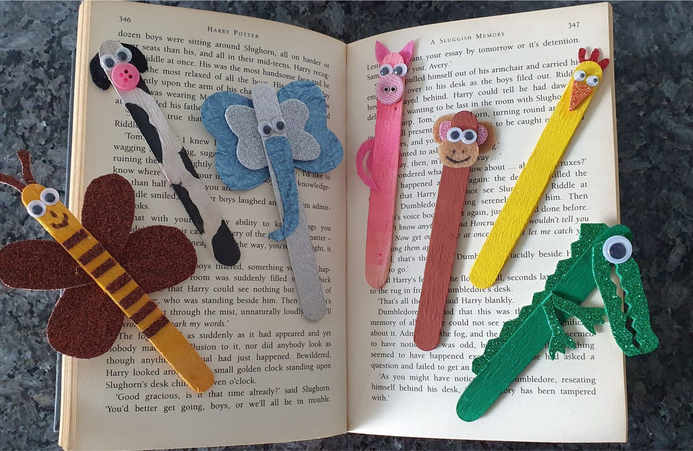
ART
MAKE FOUR DIFFERENT ANIMAL BOOK MARKS WITH WASTE ICE CREAM STICKS.

Slide 15
MODELS AND POSTERS
CLASS II A
Topic - Air Pollution
Transport /Industries creating pollution (Roll no.1 - 10)
Burning of fields (praali)creating pollution(Roll no.11-20)
Depletion of ozone layer (Roll no.21- 30)
Remedies for Air pollution (Roll no. 31-35)
Suman k (Roll no .36-39)
[0:25 pm, 25/05/2022] Mrs Kapoor: Make a sustainable city model to save electricity.[0:26 pm, 25/05/2022] Mrs Kapoor: Make a model on extinct and endangered species .[0:27 pm, 25/05/2022] Mrs Kapoor: Make posters for the same

Slide 16
MODELS AND POSTERS
CLASS II B
Topic - Noise Pollution
Causes of Noise Pollution (Roll no.1 - 10)
Effects of Noise Pollution (Roll no.11-20)
Health and Sanitation(Roll no.21- 30)
Suman K (Roll no. 31-39)
[0:25 pm, 25/05/2022] Mrs Kapoor: Make a sustainable city model to save electricity.[0:26 pm, 25/05/2022] Mrs Kapoor: Make a model on extinct and endangered species .[0:27 pm, 25/05/2022] Mrs Kapoor: Make posters for the same

