Slide 1
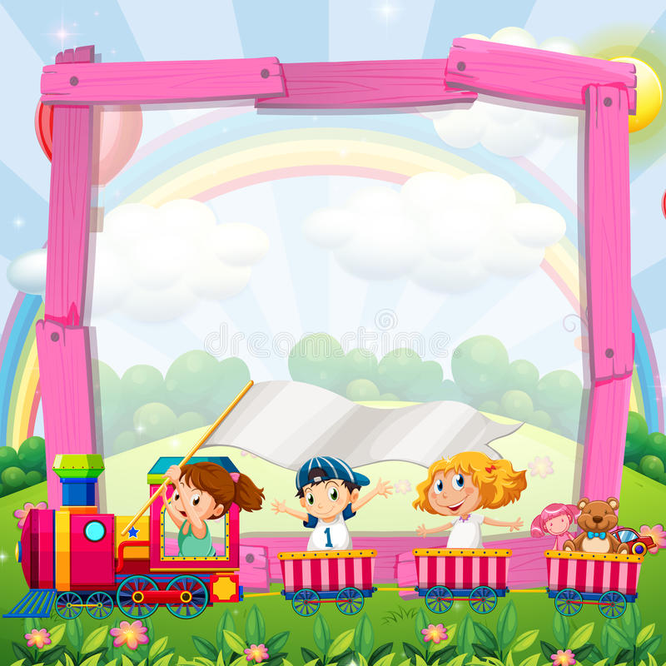
COLUMBIA FOUNDATION
SR. SEC. SCHOOL
D- BLOCK, VIKASPURI
CLASS – 3
HOLIDAY HOMEWORK
( 2024 – 2025 )

Slide 2
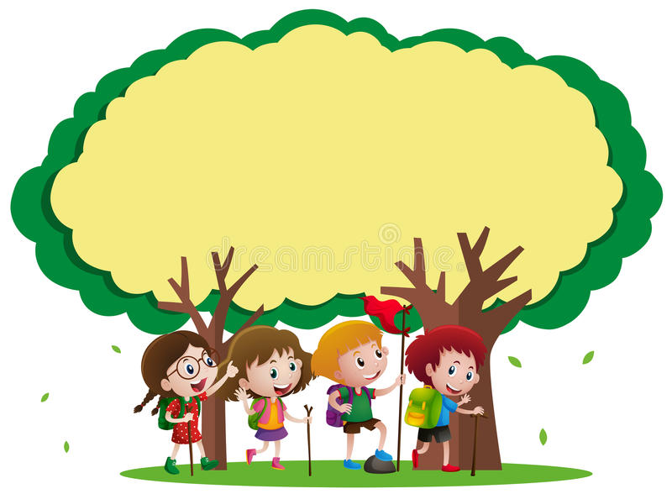
Holidays are an integral part of a student’s life . It's a time for fun , a time to explore and a time to learn in different ways . When holidays are given a meaningful direction, it results in a productive and enjoyable time. According to NEP to make learning interesting, all the subjects should be integrated. We, at Columbia believe that learning happens through critical thinking and this holiday homework will keep the child active and observant!

Slide 3
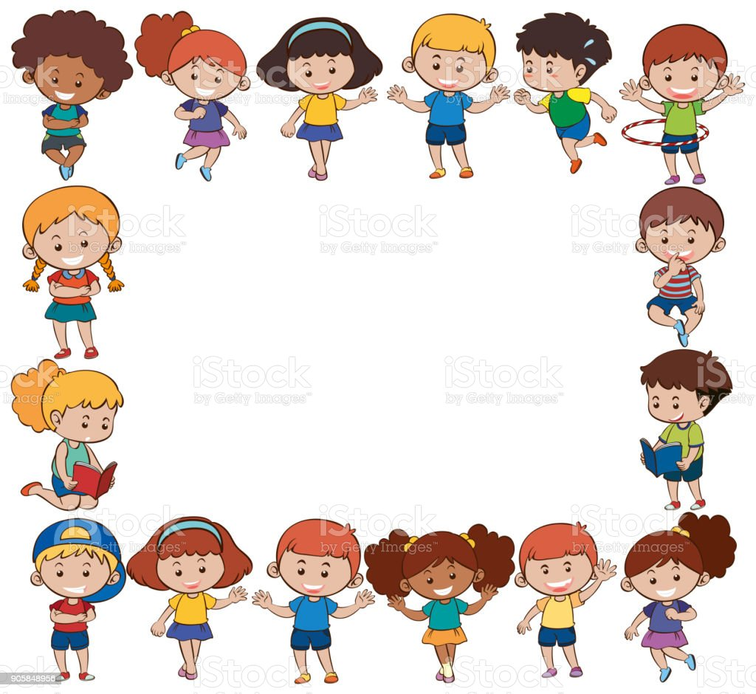
GENERAL INSTRUCTIONS
Holiday Homework for all the subjects is to be done in common file, (A- 3 sheets compiled together).
The cover page of the file should be attractive, colourful and decorated.
Illustrate the work with pictures.
Do not use thermocol because it is harmful for the environment.
Use only waste material (newspaper, old magazine, laces, buttons, fruit seeds, pencil shavings, waste plastic etc.) for model and file.
Revise the work done in all subjects.
Do your work very neatly in your own hand writing. Take help from your parents when required .
Do page no – 5 to 25 of cursive writing and hindi sulekh books .

Slide 4
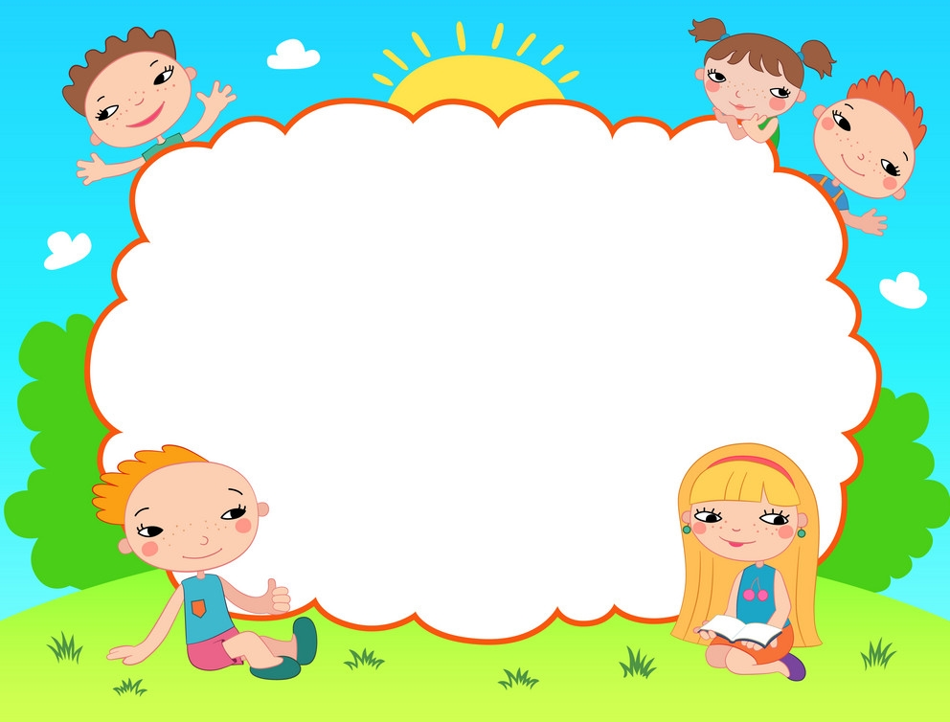
INCULCATE HEALTHY HABITS
Getting up early in the morning.
Brushing teeth twice a day.
Washing hands.
Eating lots of fruits and homemade nutritious food.
Drinking lots of water.

Slide 5

Sow the Mango Seed
Sow the seed in a waste container.
Water it regularly.
Keep it in proper sunlight. Observe it.
Click pictures and paste them in the holiday homework file.
Mention the date of sowing the seed, the sapling you saw for the first time and measure it's length twice a week.
DATE | OBSERVATION | MEASUREMENT | DRAW AND COLOUR

Slide 6
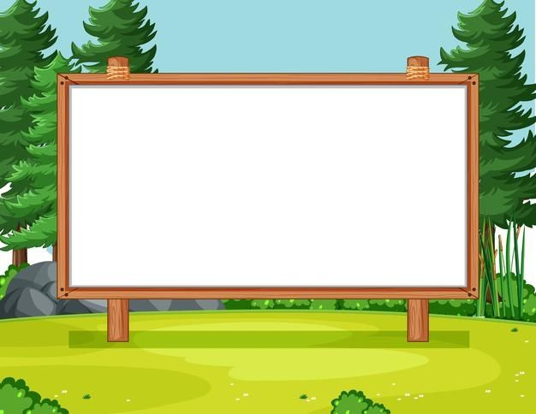
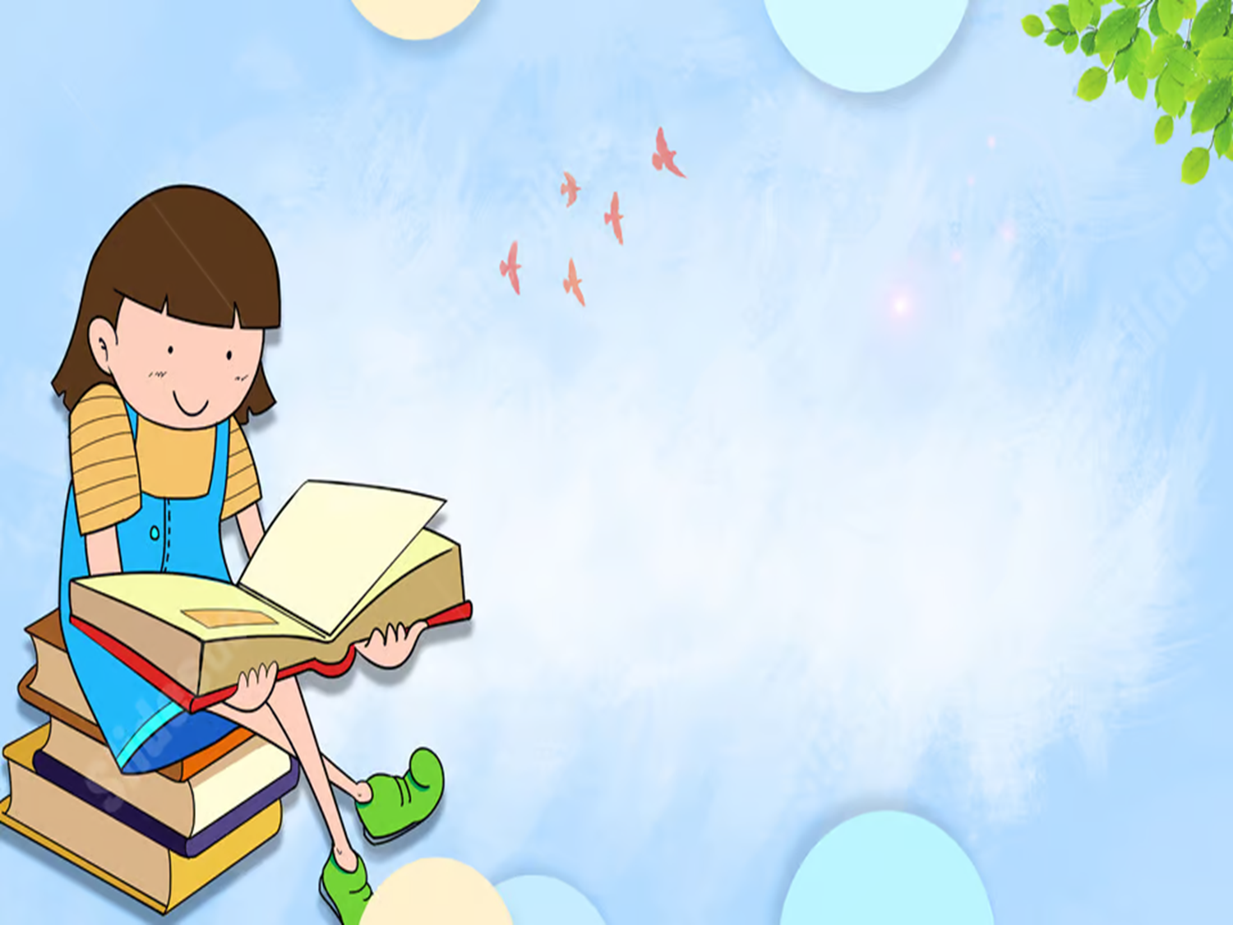
READING IS FUN
Books are our best friends. Reading books is a pleasure . It has a joy of its own. From the list of the given books :-
The Blue Umbrella by Ruskin Bond
How I taught my Grandmother to read by Sudha Murthy
The Bird with Golden wings by Sudha Murthy
Summer Time Stories by Enid Blyton
The Teacher I Never Met by Eshar Sharma
Read any one of the books and write about your favourite character in about 100 words.
Make an attractive cover page.

Slide 7

Imagine that one day you got up in the morning and found that there was no water in the taps as the water was not supplied due to the cleaning of water tanks/maintenance work in your area.
Write a paragraph in 150 words describing the problems faced by you and your family on that day.
After facing this problem what changes did you bring in yourself .

Slide 8
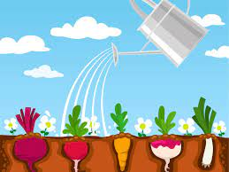

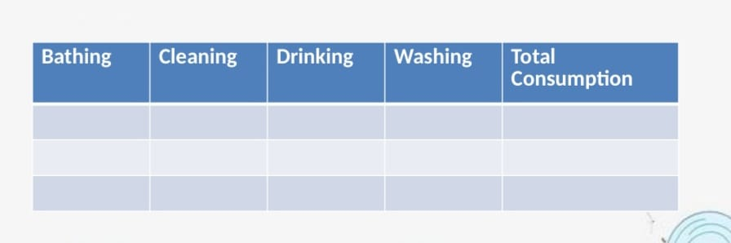
Prepare a table showing the consumption of water before and after the problem that you faced:-
(Measure the capacity of your bucket by using one litre bottle)
for e.g.- If one member of the family uses 10 litres water for bathing then calculate the capacity of water used by the total number of your family members.
You can take activities like :- Cleaning, drinking, washing, cooking, watering the plants.
After calculating the total consumption of water, what measures did you take to reduce the wastage of water. ( Illustrate with pictures)
E.V.S

Slide 9
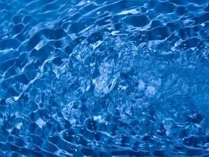
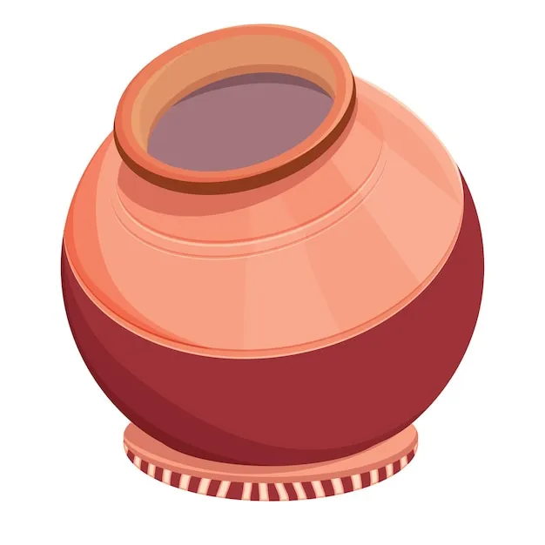
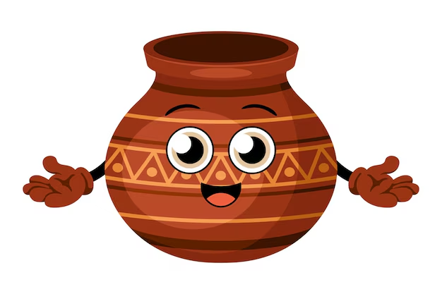

अपनी सेहत का ध्यान रखते हुए हमें फ्रिज का ठंडा पानी नहीं पीना चाहिए तथा उसके स्थान पर अगर हम घड़े का पानी पिए तो हमें क्या लाभ प्राप्त होगा? इसके विचार अपने शब्दों में चित्र सहित लिखिए। जल को बचाने संबंधित एक पोस्टर बनाइए और एक सुन्दर -सा स्लोगन लिखिए।

Slide 10
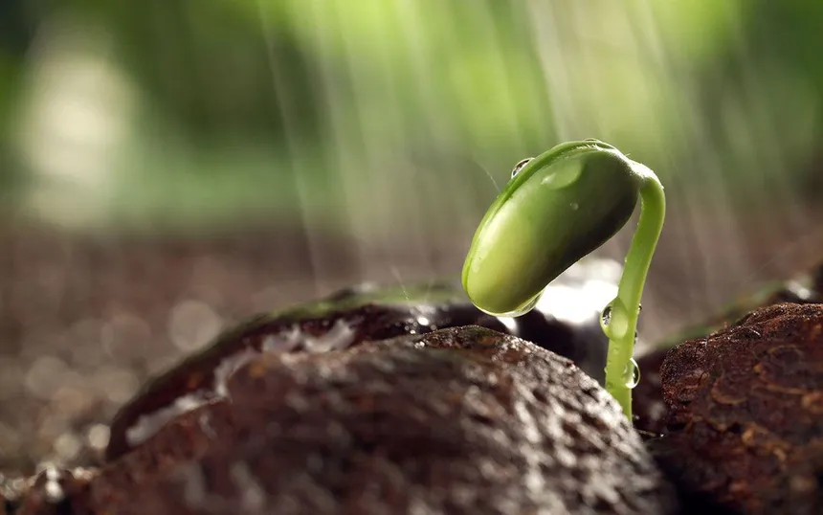
Imagine that you are a seed, share your journey from a seed to a young plant.
Also elaborate that how you feel when you are watered and how you feel when your leaves are plucked off.
Illustrate with drawing.

Slide 11
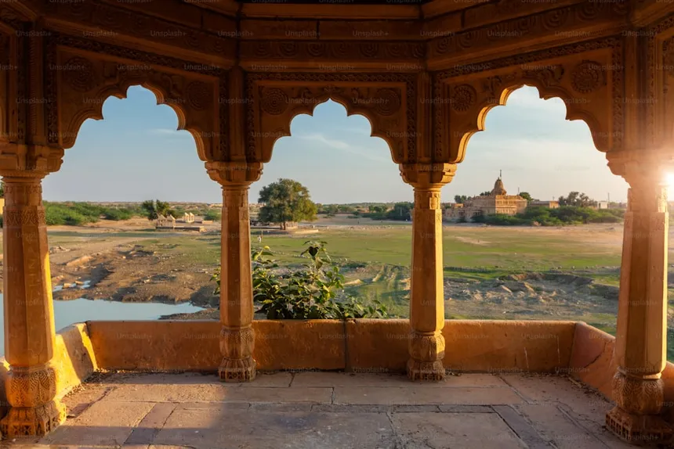
RAJASTHAN

Slide 12
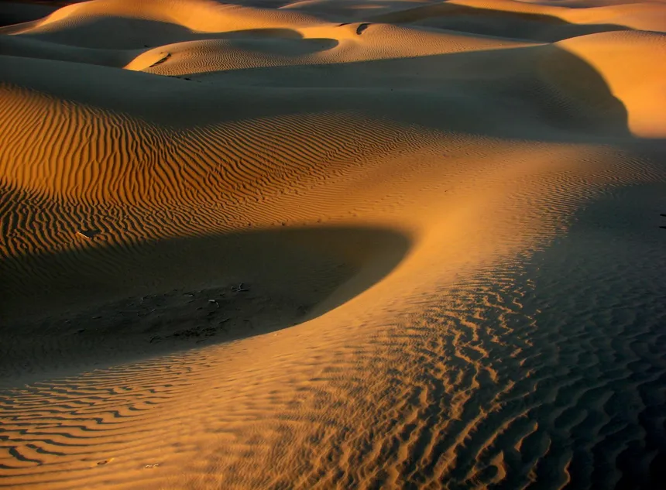
Rajasthan is the most famous tourist destination and is lovingly described as the Land of Kings or Land of Monuments. It is the combination of royal palaces, alluring forts, elegant havelis, exotic wildlife parks and extremely rich culture and heritage.
Prepare a travel brochure of Rajasthan.
( You can use table calenders or invitation cards).

Slide 13

III - A
Students have to make models and posters according to their Roll numbers.
Roll No. 1-5
Model of Kumbalgarh Fort
Poster of Prithvi Raj Chauhan
Roll No. 6-10
Model of Jal Mahal (Jaipur)
Poster of Irfan Khan cricketer
Roll No. 11-15
Model of Khatu Shyam Mandir
Poster of Pratibha Patil
Roll No. 16-20
Model of Ranthambore National Park
Poster of Rajasthani Cuisine
Roll No. 21-25
Model of Camel Safaris
Poster of Ila Arun
Roll No. 26-30
Model of Katputli
Poster of Pushkar Fair
Roll No. 31 -35
Model of Amarpali Museum(Jaipur)
Poster of Dulendhi Festival
Roll No. 36 -40
Model of Rajasthani Terracotta
Collage/poster of tourist places of Rajasthan .
(Photos and videos regarding these will be shared in class WhatsApp group)

Slide 14

III - B
Students have to make models and posters according to their Roll numbers.
Roll No. 1-5
Model of Hawamahal (Jaipur)
Poster of Maharana Pratap
Roll No. 6-10
Model of Thar Desert
Poster of Jagjit Singh
Roll No. 11-15
Model of Jaisalmer Fort
Poster of Dr. A.P.J.Abdul Kalam
Roll No. 16-20
Model of Neelkanth (Alwar)
Poster of Rajasthani Festivals
Roll No. 21-25
Model of Sariska National Reserve
Poster of Mira Bai
Roll No. 26-30
Model of Rajasthani jewellery (waste material)
Poster of kite Festival
Roll No. 31 -35
Model of Tongas
Poster of Gangaur Festival
Roll No. 36 -40
Model of Toran (waste material)
Collage of forts of Rajasthan (pastel sheets)
(Photos and videos regarding these will be shared in class WhatsApp group)

Slide 15


