Slide 1
COLUMBIA FOUNDATION SR. SEC. SCHOOL D- BLOCK, VIKASPURI
CLASS-4
Holiday Homework

Slide 2
Holidays are an integral part of a students life . It's a time for fun , a time to explore and a time to learn in different ways . When holidays are given a meaningful direction, it results in a productive and enjoyable time. According to NEP to make learning interesting, all the subjects should be integrated. We, at Columbia believe that learning happens through critical thinking and this holiday homework will keep the child active and observant!
r
.

Slide 3
GENERAL INSTRUCTIONS
Holiday Homework for all the subjects is to be done in common file, (A- 3 sheets compiled together).
The cover page of the file should be attractive, colourful and decorated.
Illustrate the work with pictures.
Do not use thermocol because it is harmful for the environment.
Use only waste material (newspaper, old magazine, laces, buttons, fruit seeds, pencil shavings, waste plastic etc.) for model and file.
Revise the work done in all subjects.
Do your work very neatly in your own hand writing. Take help from your parents when required .
Do page no – 5 to 25 of cursive writing and hindi sulekh books .

Slide 4
Inculcate healthy habits
Getting up early in the morning.
Brushing teeth twice a day.
Washing hands.
Drinking lots of water.
Eating lots of fruits and homemade nutritious food.

Slide 5
Sow the Mango Seed
Sow the seed in a waste container.
Water it regularly.
Keep it in proper sunlight. Observe it.
Click pictures and paste them in the holiday homework file.
Mention the date of sowing the seed, the sapling you saw for the first time and measure it's length twice a week.

Slide 6
READING IS FUN
Books are our best friends. Reading books is a pleasure . It has a joy of its own. From the list of the given books :-
The Blue Umbrella by Ruskin Bond
How I taught my Grandmother to read by Sudha Murthy
The Bird with Golden wings by Sudha Murthy
Summer Time Stories by Enid Blyton
The Teacher I Never Met by Eshar Sharma
Read any one of the books and write about your favourite character in about 100 words.
Make an attractive coverpage.

Slide 7
BE THE CHANGE
Create a poster on the Campaign on disposal of solid waste.
Interview 4 to 5 families in your neighbourhood and collect the data according to the following questions : -
Find out the dumping zones in Delhi
Where in your area garbage is dumped?
Where do you dumb the garbage?
Do you dispose it off collectively or separately ?
Do you reuse or send it for recycling? If yes, how?
Are you aware what happens to the waste that is dumped collectively ?

Slide 8
You need to make aware the families that you are interviewing about the harmful toxins and gases that it is generating and causing pollution.
Questions | Family 1 | Family 2 | Family 3 | Family 4 | Family 5
1
2
3
4
5
6
.

Slide 9
Imagine you had the chance to improve your neighbourhood park. What would you do to make it better?
Write in two paragraphs on how you would make a beautiful park.
Use these hints# dustbins.
# swings #more trees.
#flowers # walking path
#making others aware .
Give wings to your imagination and draw a picture of your Dream Park.

Slide 10
अपनी सेहत का ध्यान रखते हुए हमें फ्रिज का ठंडा पानी नहीं पीना चाहिए तथा उसके स्थान पर अगर हम घड़े का पानी पिए तो हमें क्या लाभ प्राप्त होगा? इसके विचार अपने शब्दों में चित्र सहित लिखिए। जल को बचाने संबंधित एक पोस्टर बनाइए और एक सुन्दर -सा स्लोगन लिखिए।

Slide 11
Starting a new Life : The courage of a seed
Create a story considering yourself as a seed. Write about your struggle to grow into a full size plant. What all are required by you to grow into a plant. How do you feel while growing up. Illustrate with drawing.

Slide 12
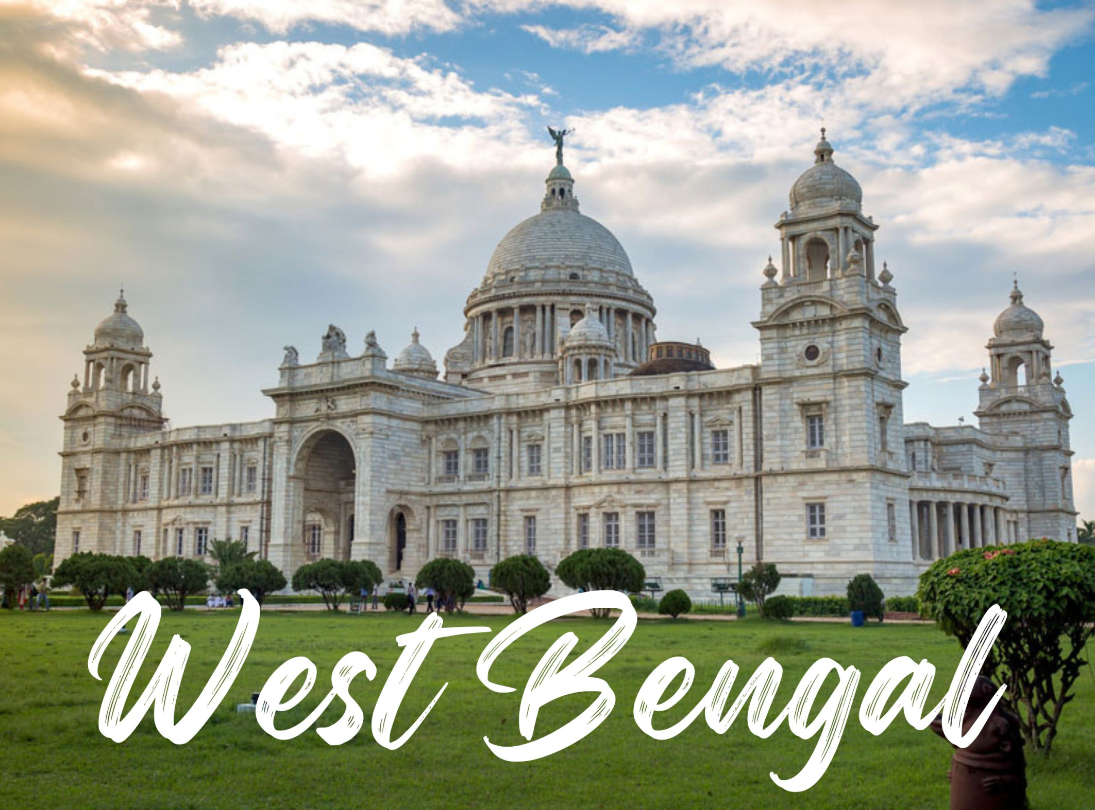

Slide 13
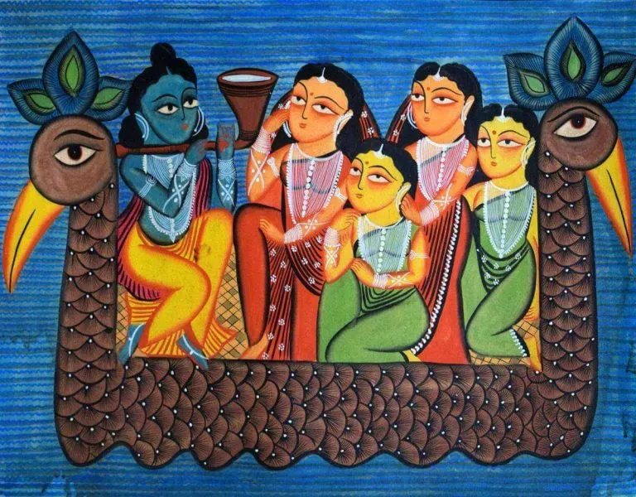
West Bengal offers a unique flavour to the richness of India with its synthesis of various languages, religions, customs, traditions, cuisines and lifestyle. Make a travel brochure of West Bengal.

Slide 14
IVA n B Students have to make models and posters according to their roll numbers.
Roll No. 1-4 Model of Howrah Bridge
Poster of R.D. Burman
Roll No. 5 -8 Model of Neta ji Subhash Chandra Bose Airport
Poster of Abhijeet Bhattacharya
Roll No. 9-12 Model of Victoria Memorial
Poster of Ishwar Chandra Vidyasagar
Roll No.13-16 Model of Sunderban Model
Poster of Raja Ram Mohan Roy
Roll No.17-20 Model of Ist Metro Rail
Poster of Rabindranath Tagore
Roll No.21-24 Model of Ist Tram Rail
Poster of Bankim Chandra Chattopadhyay
Roll No. 25-28 Model of Eden Garden Stadium
Poster of Sourav Ganguly

Slide 15
Roll No.29-32 Model of Tong
Poster of Swami Vivekanand and Pandit Ravi shankar
Roll No. 33 – 36 Model of Bengal Tiger zoo
Poster of Subhash Chandra Bose
Roll No. 37 – 40 Model of Durga Craft mask
Poster of Mother Teresa and Usha Uthap
Roll No. 41 – 43 Model of Musical Instruments and Chhau mask of West Bengal
Poster of Satyajit Ray
(Photos and videos regarding these will be shared in class WhatsApp group)

