Slide 1

COLUMBIA FOUNDATION SR. SEC. SCHOOL
D- BLOCK, VIKASPURI
CLASS – 3
HOLIDAY HOMEWORK
( 2023 – 2024 )

Slide 2

Summer vacations is probably the best time of the year for you all. It’s time for loads of ice- cream, time to stay at home and have a good time with your loved ones and getting pampered to no end and of course bonding with cousins.
School is fun too, with learning happening always.
Summer vacations can also be a time for learning with lots of activities around.

Slide 3
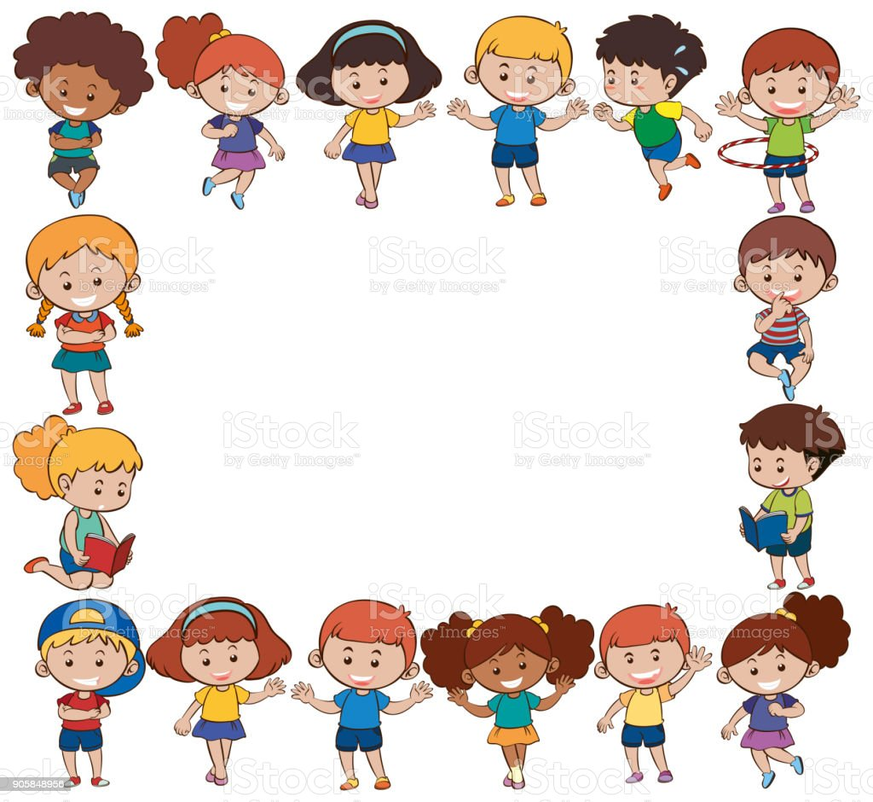
GENERAL INSTRUCTIONS
Holiday Homework for all the subjects is to be done in common file, (A- 3 sheets compiled together).
The cover page of the file should be attractive, colourful and decorated.
Illustrate the work with pictures.
Do not use thermocol because it is harmful for the environment.
Use only waste material (newspaper, old magazine, laces, buttons, fruit seeds, pencil shavings, waste plastic etc.) for model and file.
Revise the work done in all subjects.
Do your work very neatly in your own hand writing. Take help from your parents when required.

Slide 4
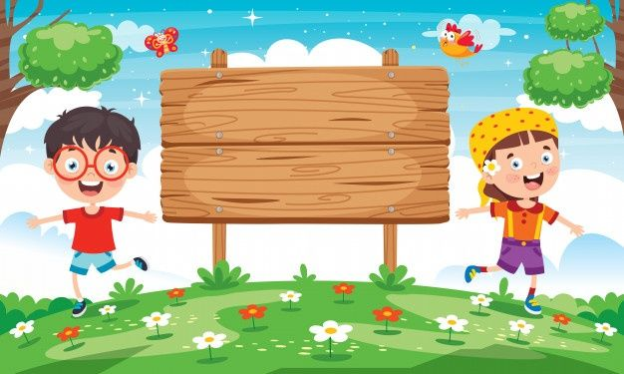
Dear Parents,
The following tips would help your child spend these holidays in a learning way…..,

Slide 5

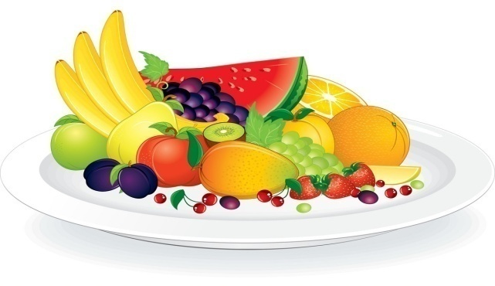
INCULCATE HEALTHY HABITS
Getting up early in the morning.
Brushing teeth twice a day.
Washing hands.
Drinking lots of water.
Eating lots of fruits and homemade nutritious food.

Slide 6
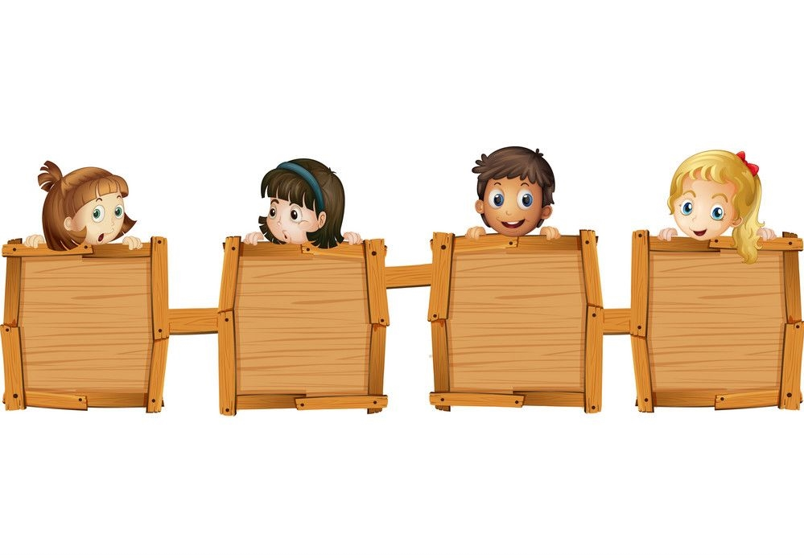
SOME TIPS TO MAKE THESE HOLIDAYS SPECIAL
Play board games with your grandparents, parents and siblings.
Have a family dinner everyday.
Be independent and learn to do some work on your own.
Spend some quality time with your grandparents.

Slide 7
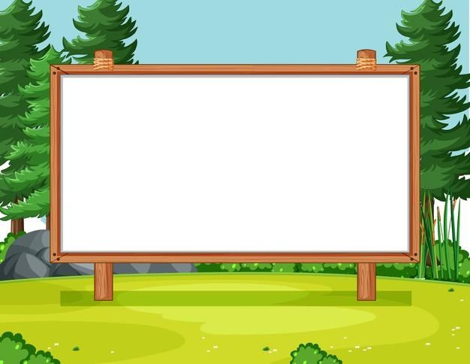

ENGLISH
1)Trees are selfless and giving.
What values can you learn from the trees?
Make a leaf shape cut out of A3 size sheet and write a value on that.
2) Your friend from next door has plants in her garden that she loves and waters everyday.
She and her family are going away for a week, so she asks you to take care of them till
she returns.
Write your experience in 6-8 sentences during that week and what value did you learn during
that process.
Also paste your photo while taking care of the plants.
Make a list of the plants that you took care of ( whether they are organic/medicinal)-
Find different ways of watering plants when you are not at home.

Slide 8
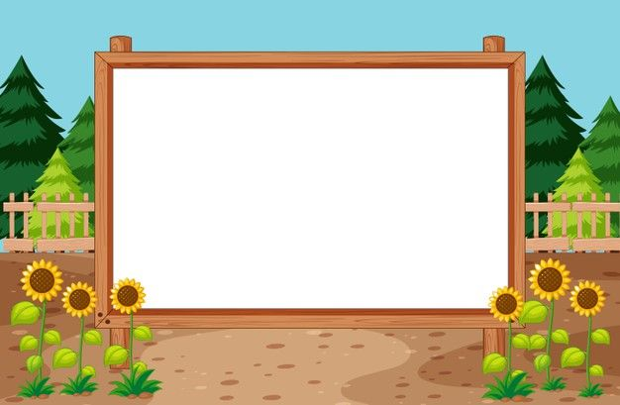
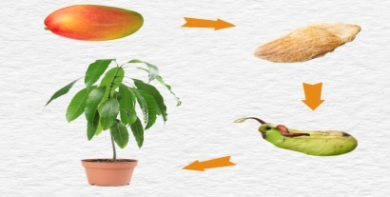
हिंदी
1) तुलसी और आंवला जैसे पौधे हमारे लिए उपयोगी हैं| इसी तरह अन्य कोई 5 पौधों के नाम चित्र सहित लिखिए और बताइए कि यह रोगों से हमारी किस प्रकार सहायता करते हैं|
*2)आधुनिक शैली में मोबाइल, फो़न, टीवी, वीडियो गेम बच्चों पर बुरा प्रभाव डाल रहें हैं| इसके लिए आउट डोर गेम को सबसे बेहतर माना गया है| कोई पांच आउट डोर और इनडोर गेम के चित्र चिपकाइए और इसके 2-2 फा़यदे लिखिए|

Slide 9
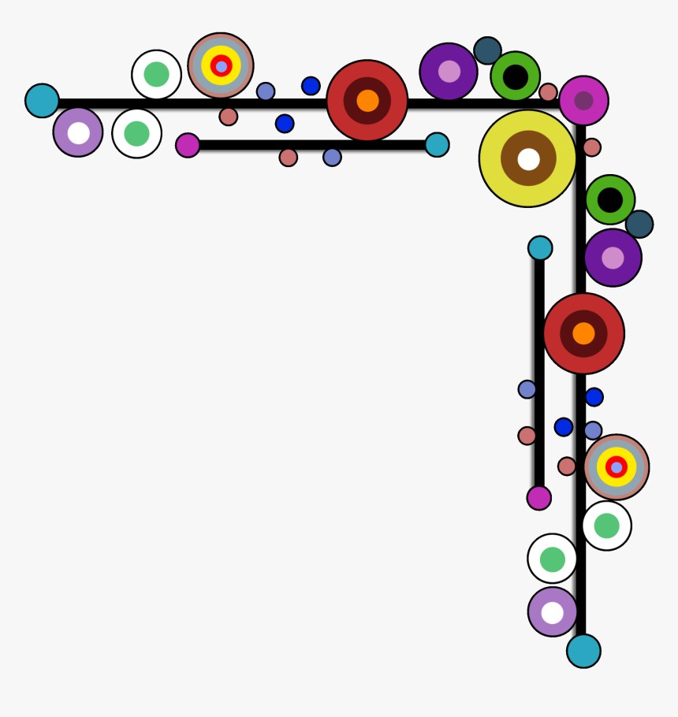
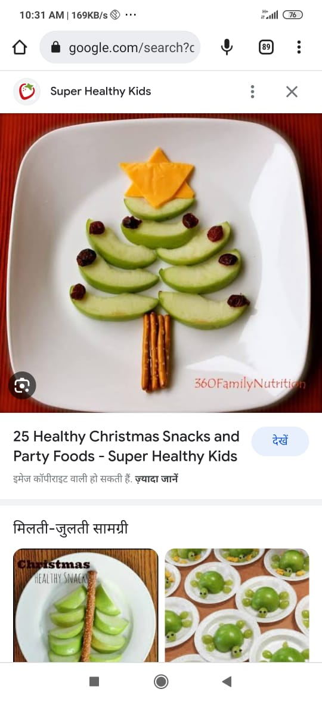
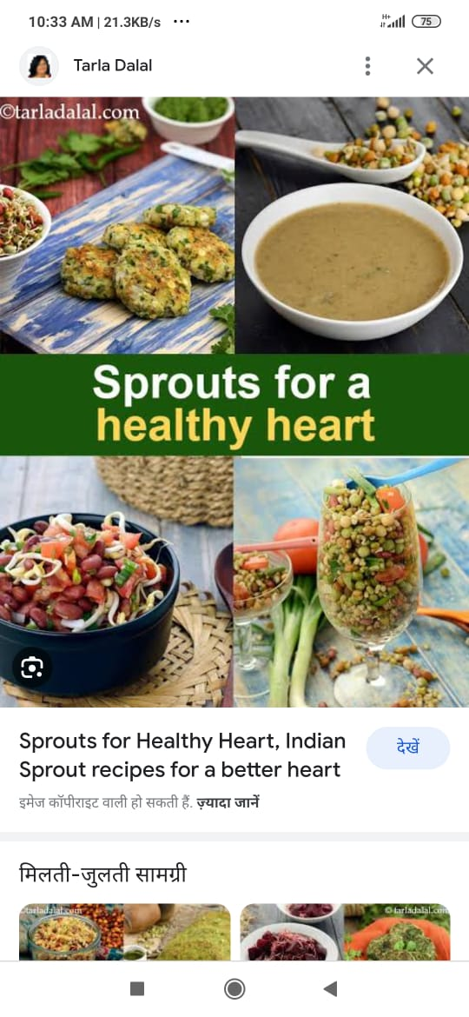
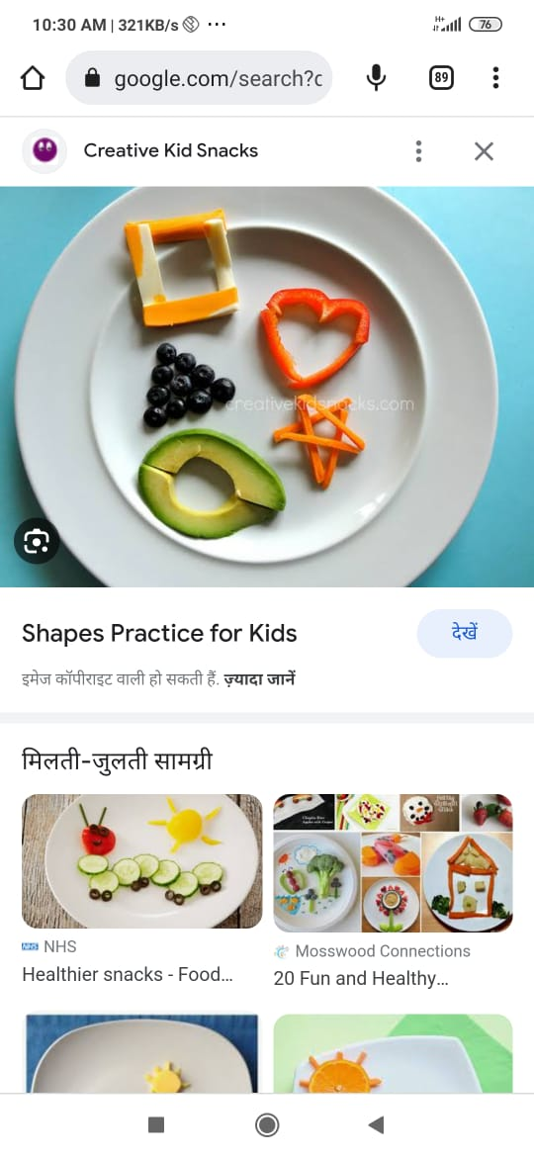
Q2. Make an “Air Quality Index Chart” Collect data of 10 days from the newspaper.
Illustrate with pictures about the causes of Air Pollution and how that can be controlled.
Make a Pollution Checker with paper plate, Vaseline and thread to check the quality of air that surrounds your house.
MATHS
Innovating with Geometrical shapes is so much fun. Prepare some healthy snacks by using cucumbers, carrots, tomatoes, onions, spinach etc in different shapes like triangles, circles, rectangle and square. Click the picture of the dish you have made and write its ingredients also.

Slide 10
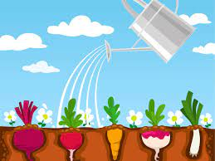
E.V.S
Share your experience by writing a beautiful 'Journey of a plant' under the following heading:
Motivation ~ What motivated me to plant a seed.
Support ~ Who all helped me in my family.
Hygiene ~ What measures I have taken to maintain hygiene.
Feelings ~ My feelings when I saw the germinated seed for the first time.
Advantage ~ Benefits of planting a seed/sapling.

Slide 11
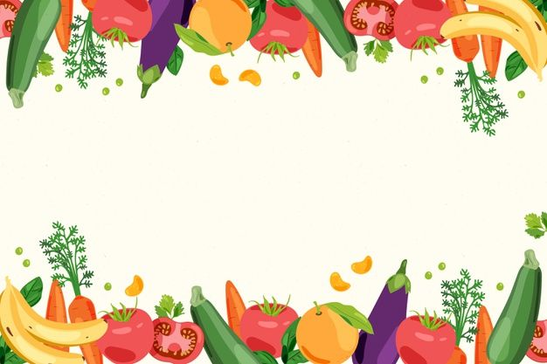
2) Visit a market near your area and look at the vegetables available there.
You will find that few vegetables are large in size.
Why do you think that the vegetables are large in size?
Are fruits and vegetables safe to eat if they have been treated with pesticides?
What difference do you find when you grow vegetables at home with that purchased from the market?

Slide 12

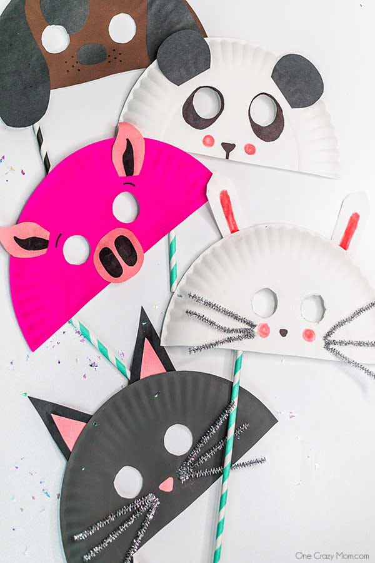
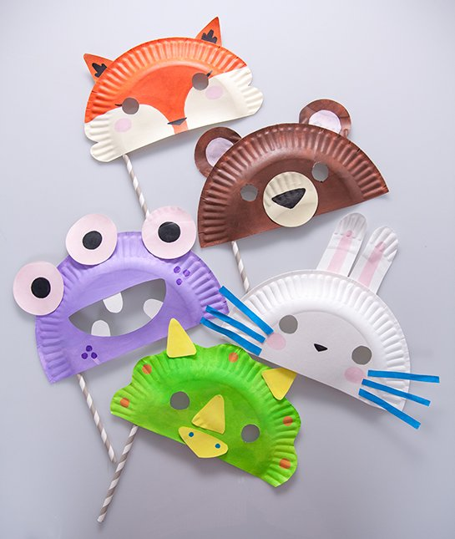
ART
Make 4 different
animal mask
with
waste paper plates

Slide 13
MODELS (CLASS 3 B)
Students have to grow these plants according to their roll numbers
Roll No. 1-5 Aloe Vera
Roll No. 6-10 Coriander
Roll No. 11-15 Tulsi
Roll No. 16-20. Mint
Roll No. 21-25 Lemon Grass
Roll No. 26-30. Amla
Roll No. 31-35. Garlic
Roll No. 36-40. Giloy
* You also have to make a photo frame of the plant that you are growing and write its benefits.* Make a wall hanging of the vegetables that you are growing.(Photos and videos regarding these will be shared in class WhatsApp group)

Slide 14


HAPPY HOLIDAYS

